Slide 1
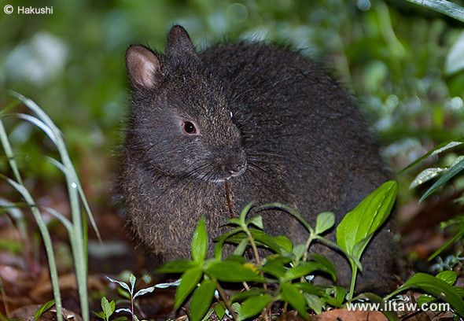
What do you need to know to save/manage a species?

Slide 2
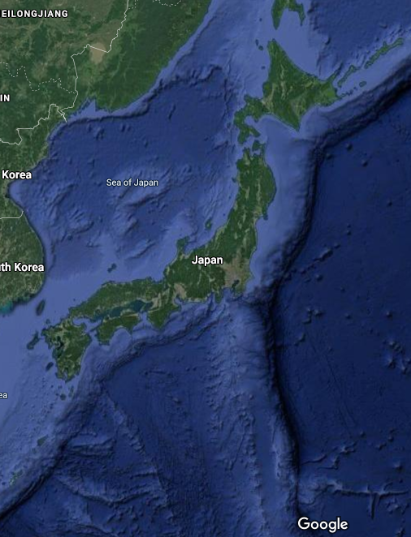
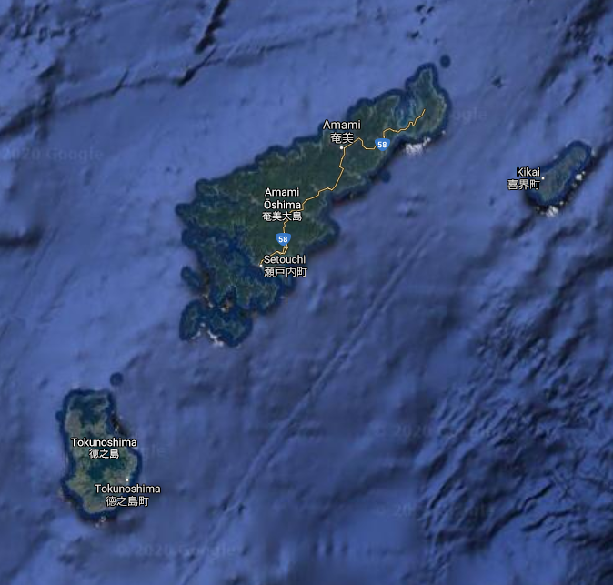
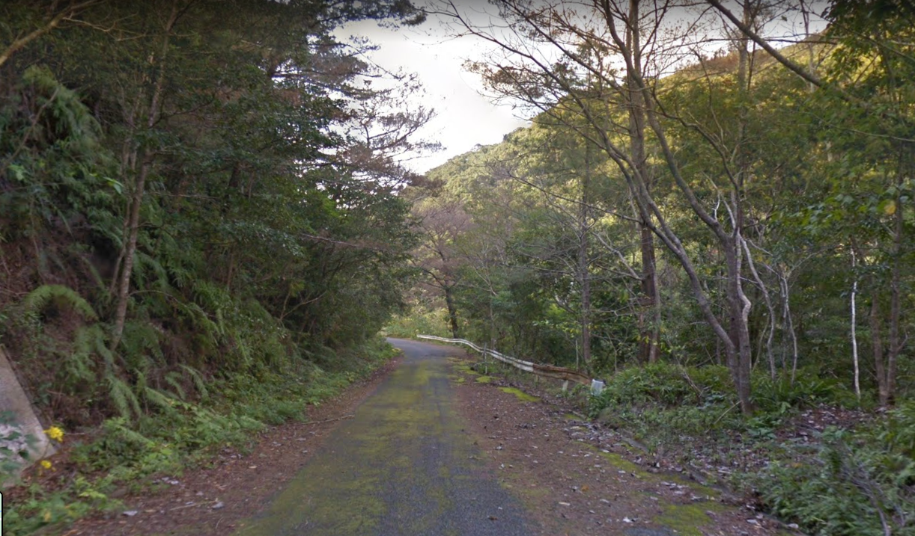
Where in the world is Carmen Santiago?
Far south of Japan,
Ryukyu Island chain,
Amami Oshima and Tokunoshima islands

Slide 3
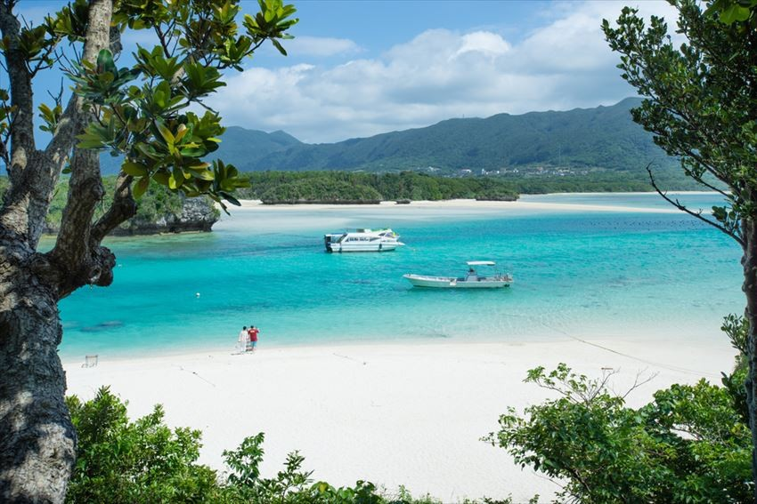

The management plan
1. Subtropical paradise Tourist destination with a “focus” on wildlife, so lots of local, national and international tourism.
2. Tourism Locals and tourists spend time in nature

Slide 4
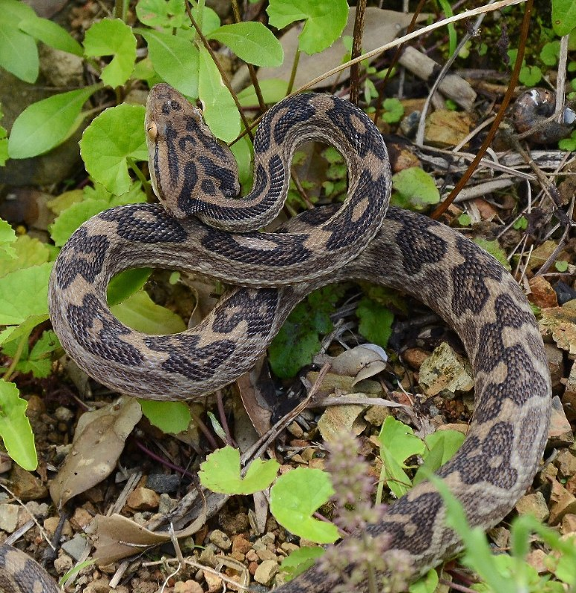
3. Public health risk 300 in 150,00 bitten each year. 0.006% of those bitten die each year

Slide 5
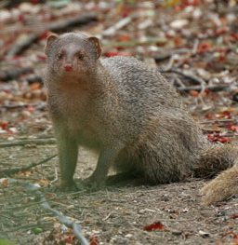
4. Death prevention Deaths viewed as unacceptable, so 30 Java mongoose (non-native) released in ‘79 to reduce Habu snake numbers

Slide 6
5. Unforeseen consequences Mongoose don’t target snakes, instead they go for Amami rabbits and reduce population substantially

Slide 7
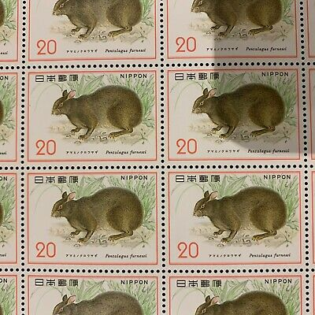
6. Cultural value Mongoose Amami rabbit is designated as “special national treasure”
2. Tourism Locals and tourists spend time in nature

Slide 8
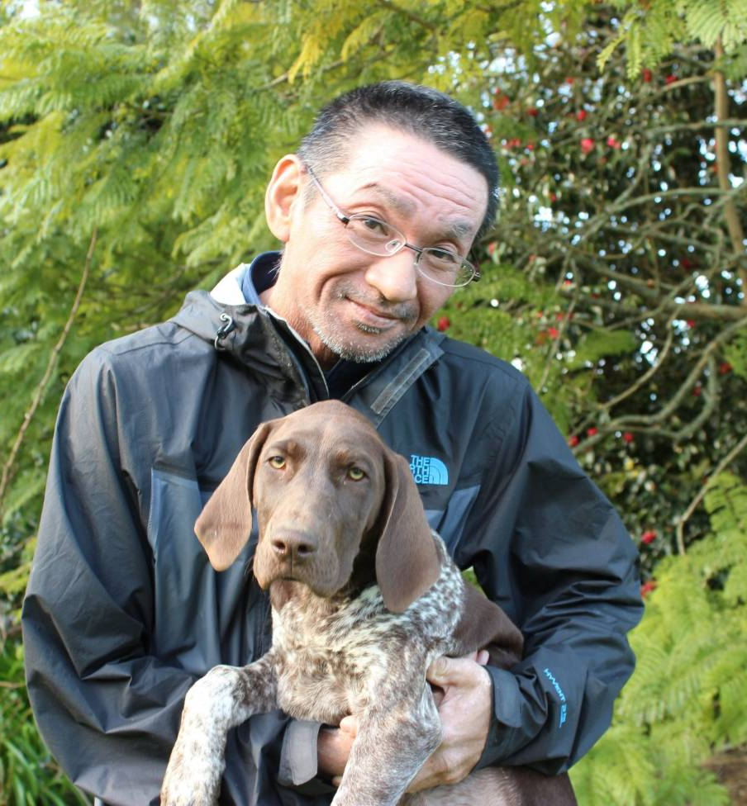
6. Mongoose busters In 2005 management team called “Mongoose Busters” begins mongoose control to save Amami rabbit. Initially claim eradication, but now shifted to 2023.

Slide 9
What is the first piece of information you require?

Slide 10
What would we like to know?
Abundance
Annual rate of population change (λ = N_{t+1} / N_{t})
Sex and age specific survival rates
Sex and age specific causes of mortality
Age structure
Sex ratio

Slide 11
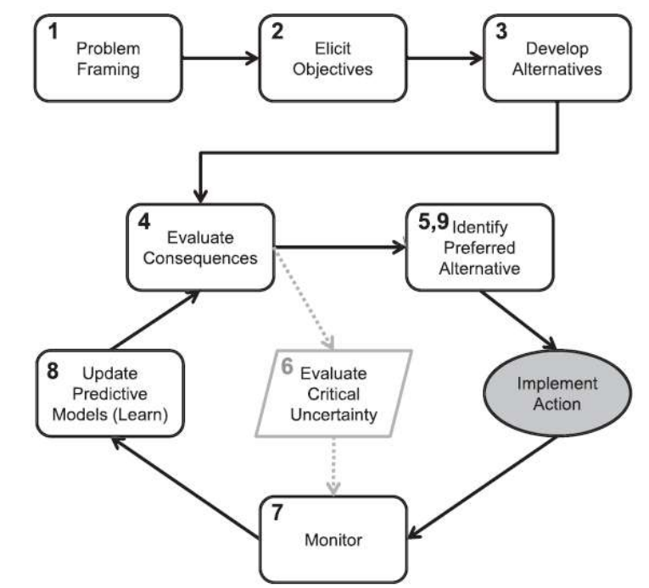
Adaptive management
Is there a problem?
What is the population trend of the species?

Slide 12
Why estimate population size?
Essential to detect trends
Important for making informed management decisions
Management goals often expressed in terms of population size
The scope of most formal monitoring

Slide 13
A menu of options
Abundance assessment techniques
Estimates
Indices
All individuals seen
Some individuals not seen
Complete Census
Capture
Census on sample plot
Removal
Capture-Mark-Recapture
Transect
Sightability models
Distance sampling
Double sampling Multiple observers

Slide 14

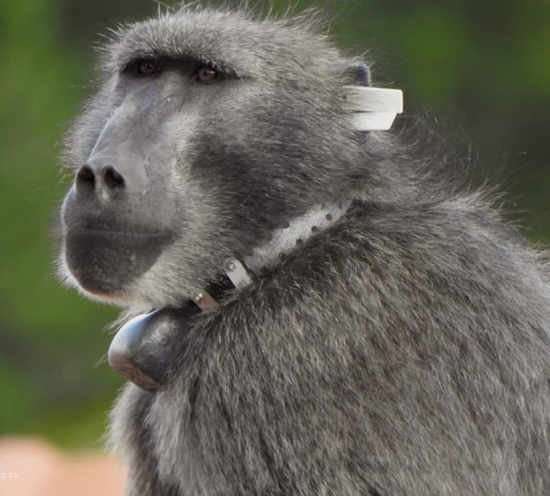
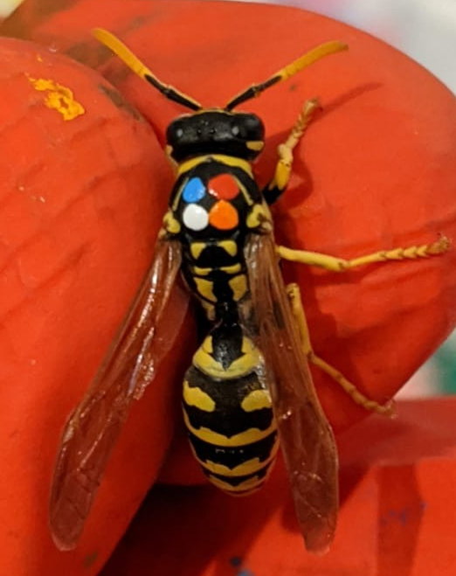
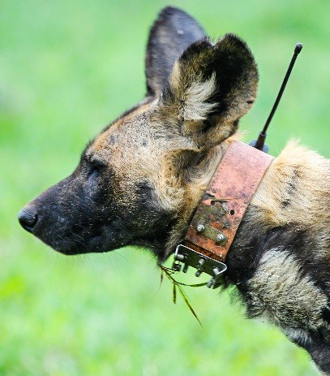
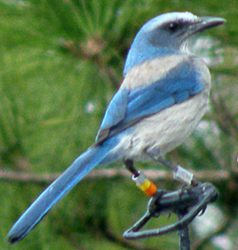

Individually marking animals
Types of marks:
Radio/GPS collars
Legbands
PIT tags
Picric acid
Individual

Slide 15
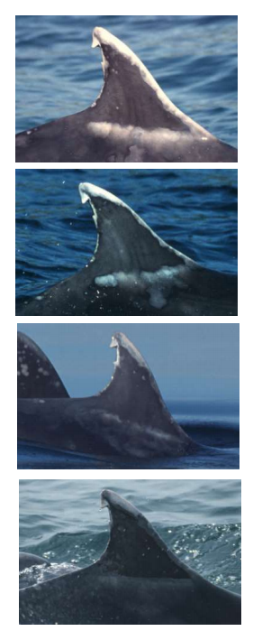
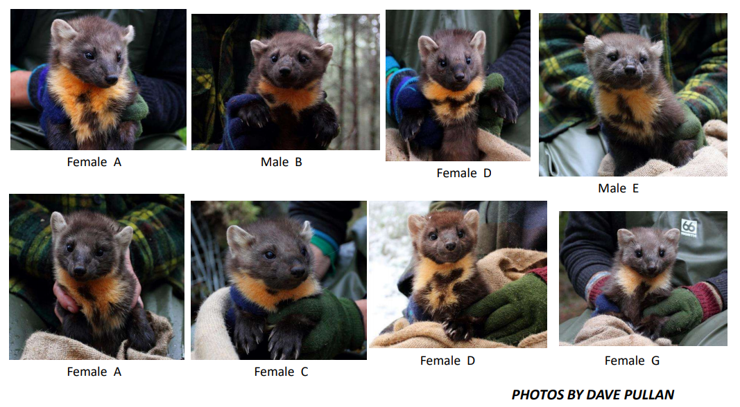
Or let nature mark them for you

Slide 16
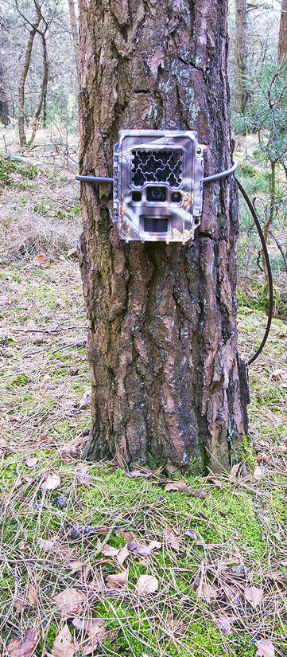
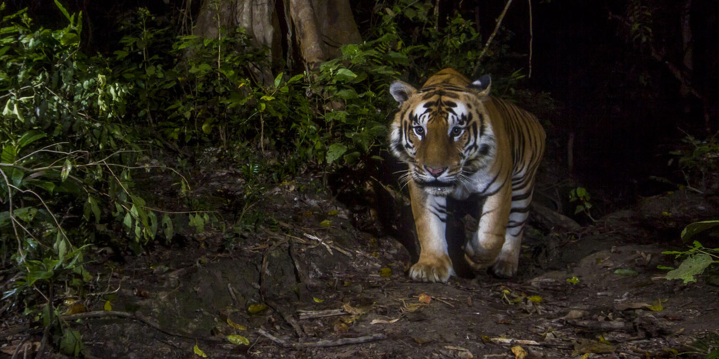
Traps can be passive (rather than active)

Slide 17
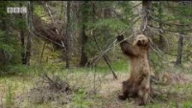
Traps can be passive (rather than active)

Slide 18
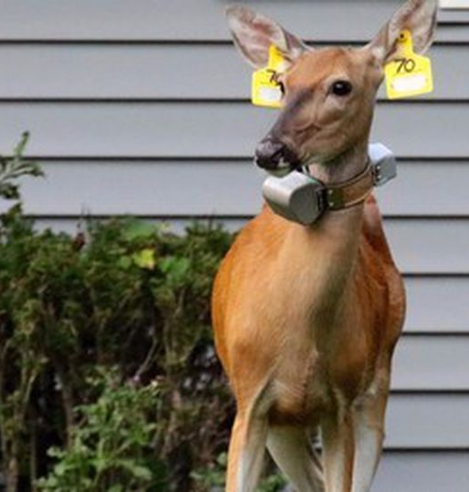
Basic principle of CMR
Can identify individuals
Subsequent re-sighting of recapture
Invariably, not all individuals who are alive are recorded on all occasions
“Incomplete registration”

Slide 19

What is a closed population?
First survey
Time between surveys
Second survey
If a population is closed, we assume that there is a short time between surveys, where no reproduction or death occurs and no individuals enter or leave the site

Slide 20

What is an open population?
First survey
Time between surveys
Second survey
If a population is open, we assume that reproduction or death occurs (more on this next week)

Slide 21
First principles of CMR
Simplest scenario:
2 samples taken very close in time
Animals are captured in a given location on a given “day”. All individuals are marked and released
A few days later, animals are trapped again in the same location
Estimate population abundance based on
Number of animals captured on each occasion and
Number of marked individuals recaptured

Slide 22
Wide variety of models available
Closed Population CMR models:
Lincoln-Peterson model (2 samples)
Allows estimation of population size
But has restrictive model assumptions
General K-samples models (>2 samples)
Allows 3 key sources of variation in capture rate to be accounted for:
Time
Heterogeneity
Behaviour
Open Population CMR models:
Used to estimate individual survival rather than population size
More on this next week

Slide 23
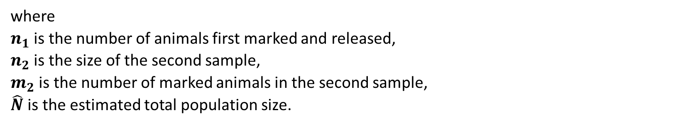
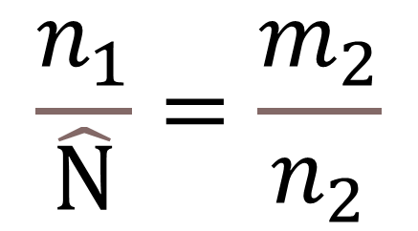

Lincoln-Peterson Estimator
Rearrange equation
$$\frac{n_{1}}{\hat{N}}=\frac{m_{2}}{n_{2}}$$
$$\hat{N}=\frac{n_{1}∗n_{2}}{m_{2}}$$
Parameter
where $n_{1}$ is the number of animals first marked and released, $n_{2}$ is the size of the second sample, $m_{2}$ is the number of marked animals in the second sample, $\hat{N}$ is the estimated total population size.
Observed data

Slide 24
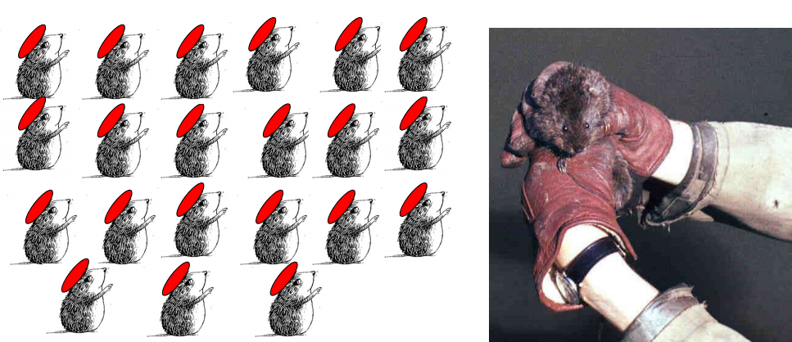
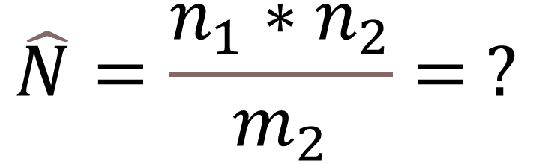
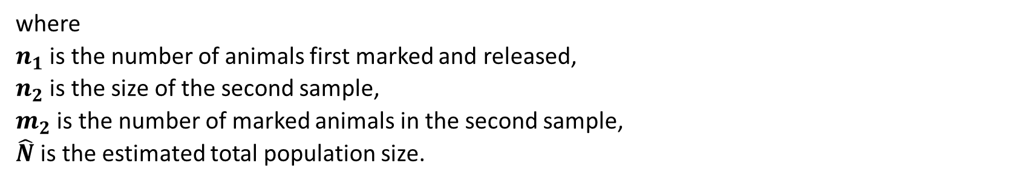
DIY population size estimation
where $n_{1}$ is the number of animals first marked and released, $n_{2}$ is the size of the second sample, $m_{2}$ is the number of marked animals in the second sample, $\hat{N}$ is the estimated total population size.
$$\hat{N}=\frac{n_{1}∗n_{2}}{m_{2}}= ?$$
57 water voles captured on 1st occasion 42 water voles captured on 2nd occasion
21 of 42 were recaptures

Slide 25
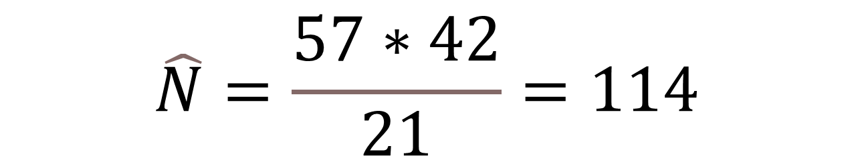
DIY population size estimation
$$\hat{N}=\frac{57∗42}{21}=114$$
where $n_{1}$ is the number of animals first marked and released, $n_{2}$ is the size of the second sample, $m_{2}$ is the number of marked animals in the second sample, $\hat{N}$ is the estimated total population size.
57 water voles captured on 1st occasion 42 water voles captured on 2nd occasion
21 of 42 were recaptures

Slide 26

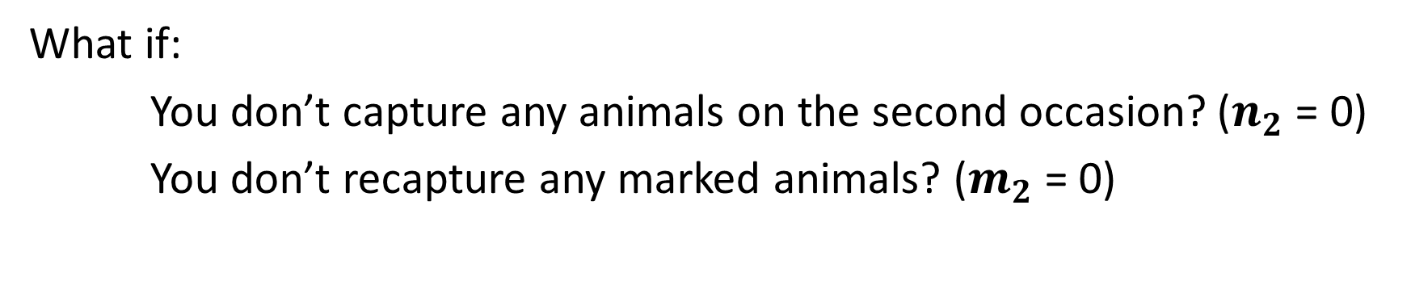
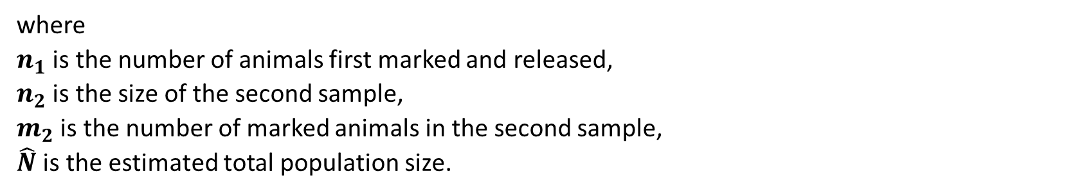
Some issues with Lincoln-Peterson
where $n_{1}$ is the number of animals first marked and released, $n_{2}$ is the size of the second sample, $m_{2}$ is the number of marked animals in the second sample, $\hat{N}$ is the estimated total population size.
$$\hat{N}=\frac{n_{1}∗n_{2}}{m_{2}}= ?$$
What if:
You don’t capture any animals on the second occasion? ($n_{2}$ = 0)
You don’t recapture any marked animals? ($m_{2}$ = 0)

Slide 27
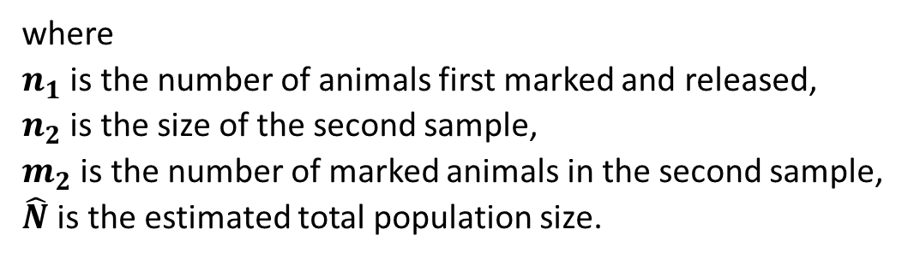
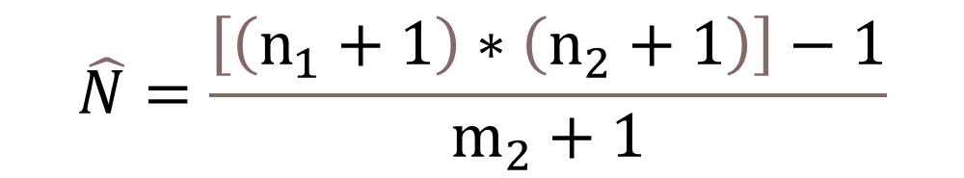
Chapman Estimator
When sample sizes are small, Lincoln-Peterson is not satisfactory
But we can modify our initial model to account for this:
$$\hat{N}=\frac{\left[\left(n_{1}+1\right)∗\left(n_{2}+1\right)\right]−1}{m_{2}+1}$$
where $n_{1}$ is the number of animals first marked and released, $n_{2}$ is the size of the second sample, $m_{2}$ is the number of marked animals in the second sample, $\hat{N}$ is the estimated total population size.

Slide 28

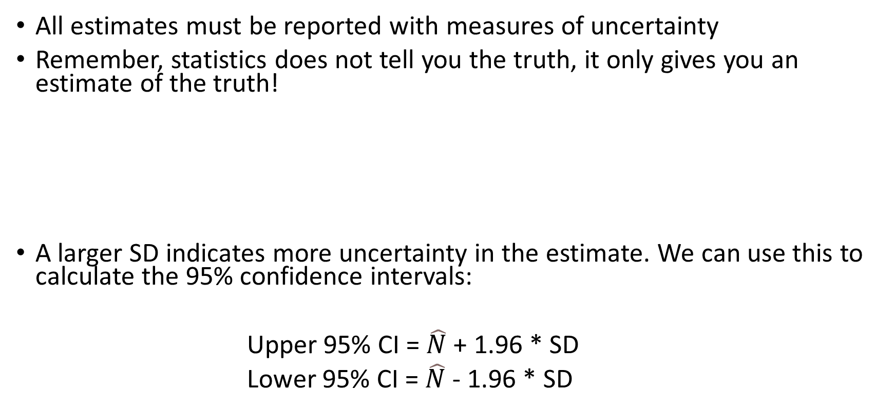
Golden rule of all statistics
All estimates must be reported with measures of uncertainty
Remember, statistics does not tell you the truth, it only gives you an estimate of the truth!
A larger SD indicates more uncertainty in the estimate. We can use this to calculate the 95% confidence intervals:
Upper 95% CI = $\hat{N}$ + 1.96 * SD
Lower 95% CI = $\hat{N}$ - 1.96 * SD
$$SD=\sqrt{\frac{\left(n_{1}+1\right)∗\left(n_{2}+1\right)∗\left(n_{1}−m_{2}\right)∗\left(n_{2}−m_{2}\right)}{{\left(m_{2}+1\right)}^{2}∗\left(m_{2}+2\right)}}$$

Slide 29
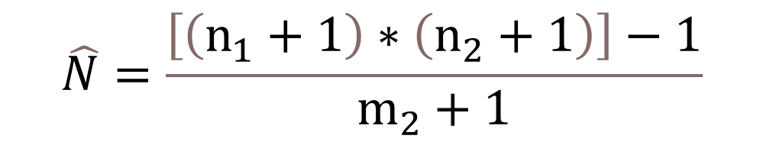
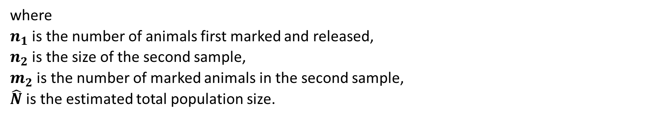
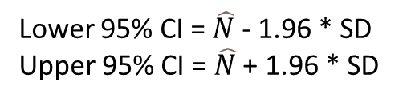

DIY population size estimation using Chapman
$$\hat{N}=\frac{\left[\left(n_{1}+1\right)∗\left(n_{2}+1\right)\right]−1}{m_{2}+1}$$
Lower 95% CI = $\hat{N}$ - 1.96 * SD
Upper 95% CI = $\hat{N}$ + 1.96 * SD
$$SD=\sqrt{\frac{\left(n_{1}+1\right)∗\left(n_{2}+1\right)∗\left(n_{1}−m_{2}\right)∗\left(n_{2}−m_{2}\right)}{{\left(m_{2}+1\right)}^{2}∗\left(m_{2}+2\right)}}$$
where $n_{1}$ is the number of animals first marked and released, $n_{2}$ is the size of the second sample, $m_{2}$ is the number of marked animals in the second sample, $\hat{N}$ is the estimated total population size.
57 water voles captured on 1st occasion 42 water voles captured on 2nd occasion
21 of 42 were recaptures

Slide 30
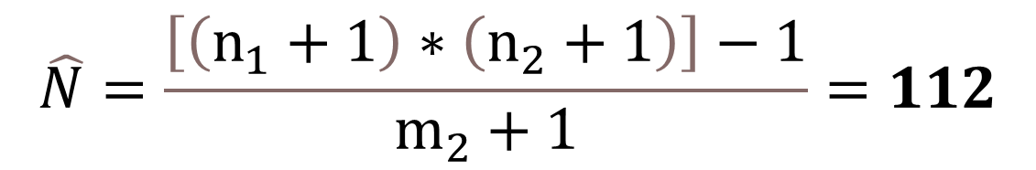
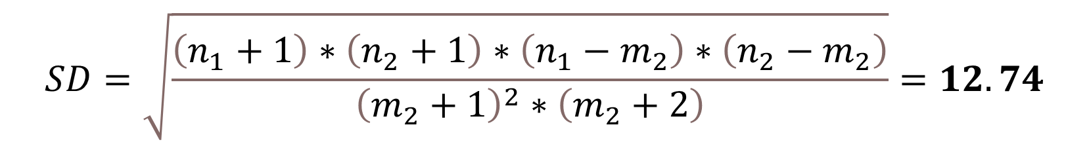
DIY population size estimation using Chapman
$$\hat{N}=\frac{\left[\left(n_{1}+1\right)∗\left(n_{2}+1\right)\right]−1}{m_{2}+1}=112$$
Lower 95% CI = 112 - 1.96 * 12.7 = 87
Upper 95% CI = 112 + 1.96 * 12.7 = 137
$$SD=\sqrt{\frac{\left(n_{1}+1\right)∗\left(n_{2}+1\right)∗\left(n_{1}−m_{2}\right)∗\left(n_{2}−m_{2}\right)}{{\left(m_{2}+1\right)}^{2}∗\left(m_{2}+2\right)}}=12.74$$
where $n_{1}$ is the number of animals first marked and released, $n_{2}$ is the size of the second sample, $m_{2}$ is the number of marked animals in the second sample, $\hat{N}$ is the estimated total population size.
57 water voles captured on 1st occasion 42 water voles captured on 2nd occasion
21 of 42 were recaptures

Slide 31
Assumptions of the Lincoln-Peterson/Chapman models
All marks are recorded correctly
Animals do not lose their marks during data collection
The population is closed
Each animal has the same probability of being captured at any time
Animals must mix in the population
Assumption 3 is realised when little time separates capture attempts.
Assumptions 4 & 5 are usually questionable and lead to biases.

Slide 32
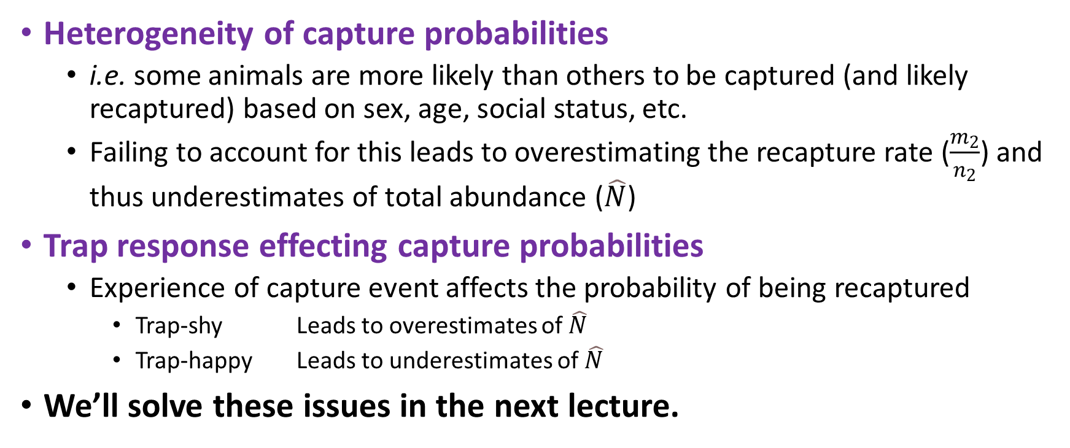
Variation in capture probabilities
Heterogeneity of capture probabilities
i.e. some animals are more likely than others to be captured (and likely recaptured) based on sex, age, social status, etc.
Failing to account for this leads to overestimating the recapture rate ($\frac{m_{2}}{n_{2}}$) and thus underestimates of total abundance ($\hat{N}$)
Trap response effecting capture probabilities
Experience of capture event affects the probability of being recaptured
Trap-shy Leads to overestimates of $\hat{N}$
Trap-happy Leads to underestimates of $\hat{N}$
We’ll solve these issues in the next lecture.

Slide 33
tl;dr
1st crucial piece of info for managing species is to figure out population trend
Can achieve this by estimating population sizes at different times
“Simple” Lincoln-Peterson model was the first solution
But has problems (no captures or recaptures on 2nd occasion)
Chapman model improves upon Lincoln-Peterson model
But still has issues
Any estimate must be accompanied with measures of uncertainty
Ideally 95% confidence intervals

